Slide 1
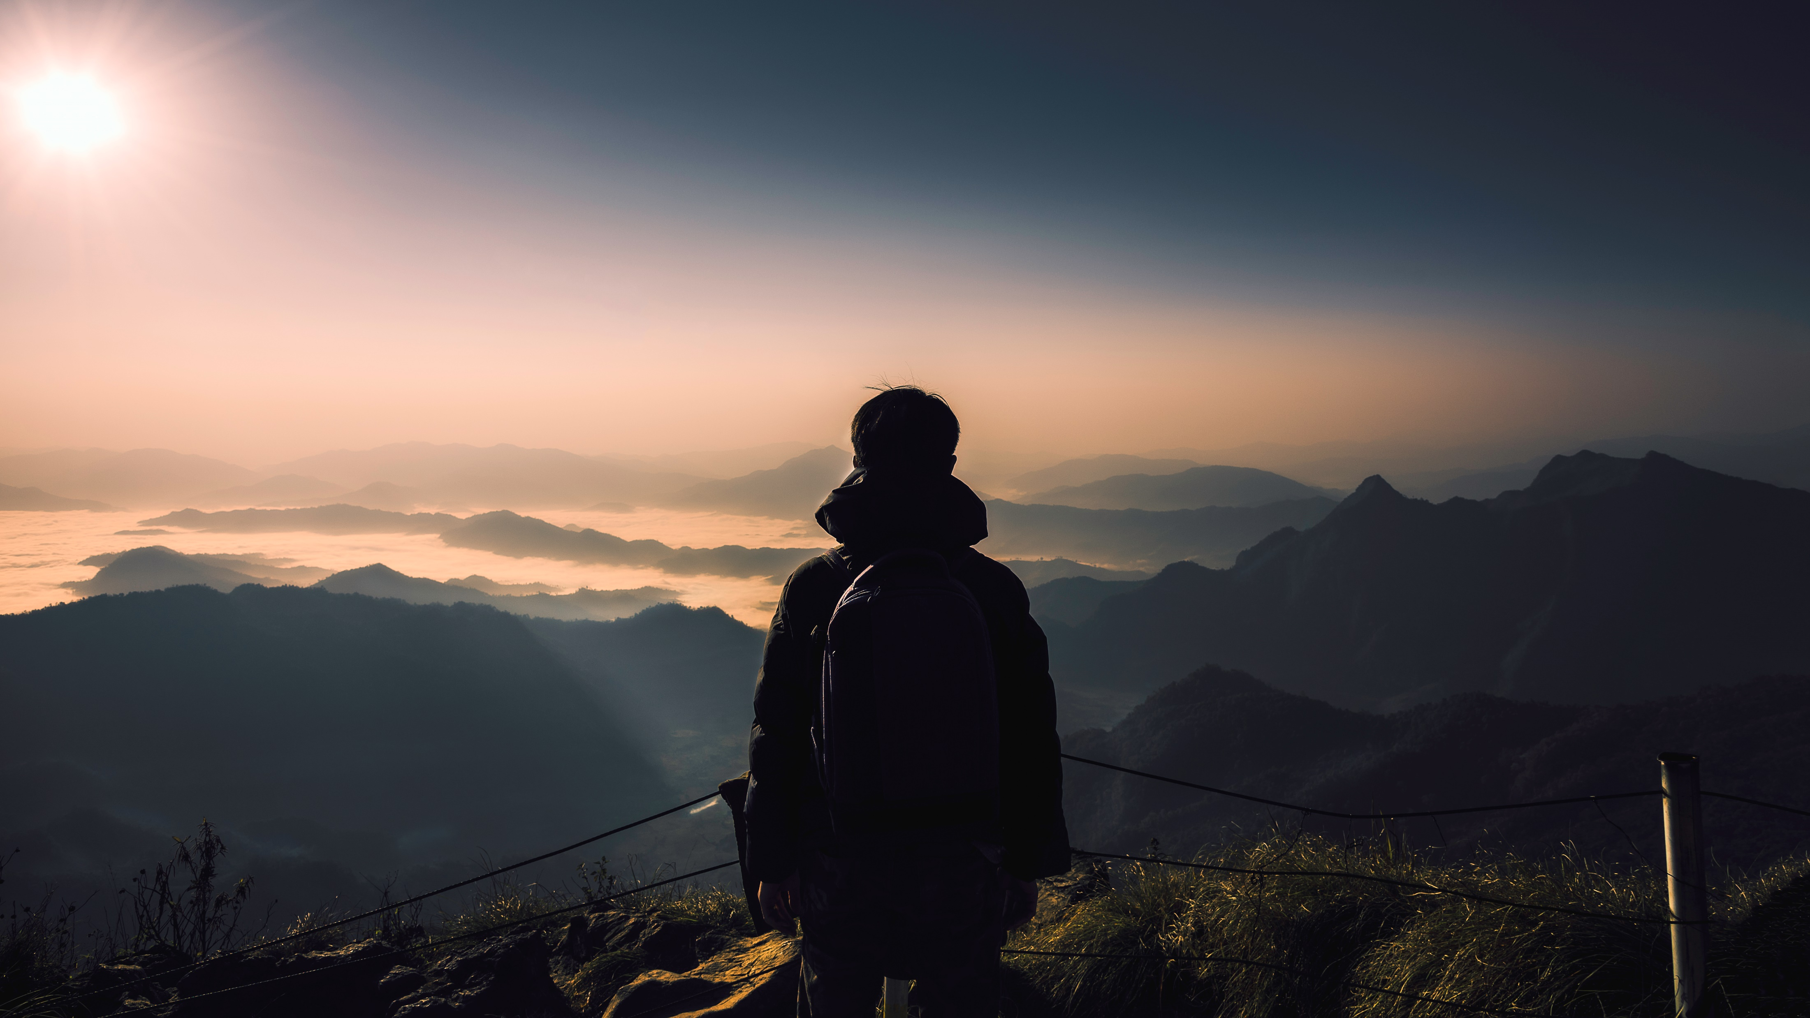
MySTERIOUS PLACES IN INDIA
Prepared by
Sneha C I

Slide 2
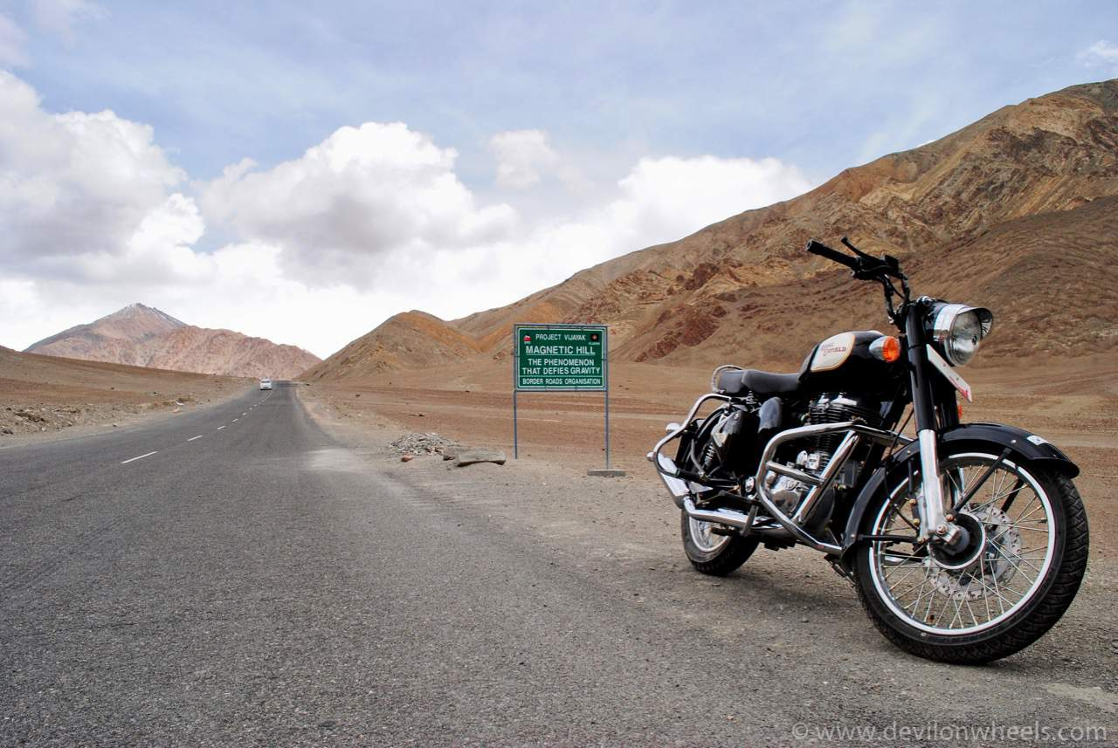
How to Start Being a Digital Nomad
The Magnetic Hill Of Leh, Ladakh
Reduce and Eliminate Expenses
Decide on a Location
Set Goals and Create a Plan
The enchanting hills of Ladakh have more than mere beauty to offer. The Magnetic Hill, located at an altitude of 11,000 feet above sea level is one of the most unusual places to visit in India.

Slide 3
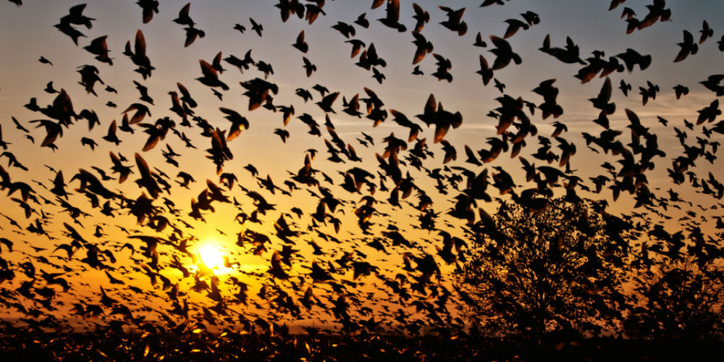
The Place Of Suicidal Birds In Jatinga, Assam
An otherwise quaint and picturesque little village in Assam, Jatinga experiences a bizarre, yet sad phenomenon every monsoon. This rare occurrence makes this village the most mysterious place in India.

Slide 4
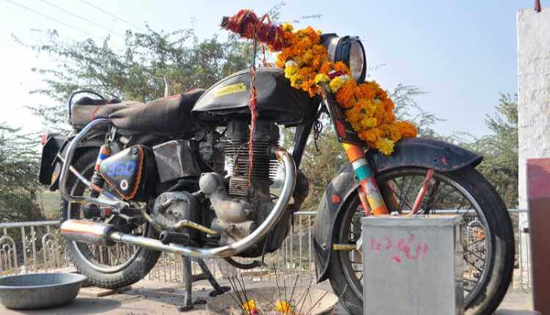
The Shrine Of The Bullet Baba In Bandai, Rajasthan
There is a famous shrine somewhere in Rajasthan, that is believed to protect travelers. But what makes this one unique is the fact that people don’t worship the usual figurines of Gods and Goddesses here. What they worship, is a motorcycle!

Slide 5

Thank you

